Slide 1
A GUI Example Using Python

Slide 2
Instructor – Ray Smith raysmith@alum.mit.edu
Many years of Programming – engineering, scientific, financial
Commercial, Scientific, Systems Languages – C, C++, Perl, Java, Python, Assembly
NEW Areas - Games for young 3-8 years
Notes:
What would you like to know about me?

Slide 3
Objectives
Sample Graphic User Interface (GUI)
Demonstrate Operations and Methods
Show ideas / issues behind GUI Software
Notes:
What do you want from this course?
What do you want from programming?

Slide 4
Our Online Session – Using Zoom
If any background noise, please mute – minimizes cumulative noise
Disable own video – too many reduces clarity
Can question via Chat – can be to ALL
Expecting Response: Start "QUESTION:"
Notes:
What do you want from this session?
What do you want from programming?

Slide 5
Approximate Session Layout
Lecture and Demonstration: 1.5 Hours
Follow-up Questions: .5 Hours

Slide 6
Featured Example – Keyboard Drawing Program Target Audience: Children 3-8 Years Old
Limited – Non-production
On GitHub: raysmith619
Program: keyboard_draw
Support: resource_lib
https://github.com/raysmith619/keyboard_draw

Slide 7
Keyboard Drawing Program Features / Attributes
Totally keyboard driven (can be)
Simultaneous screen keyboard simulation / display
Adjustable screen keyboard size
Line, Shape, Letter, Image Markers
Simple undo (no redo yet)

Slide 8
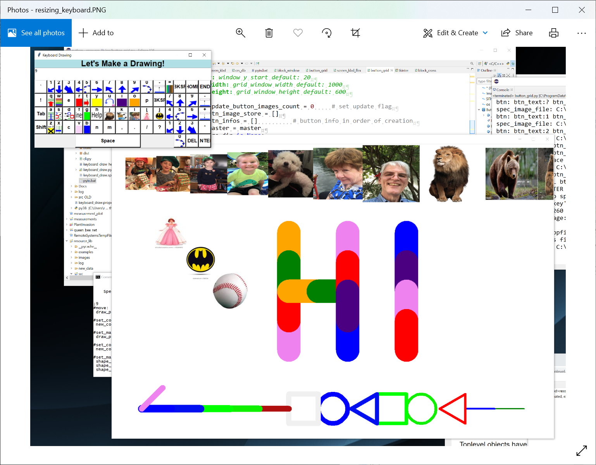
Screen Shot

Slide 9
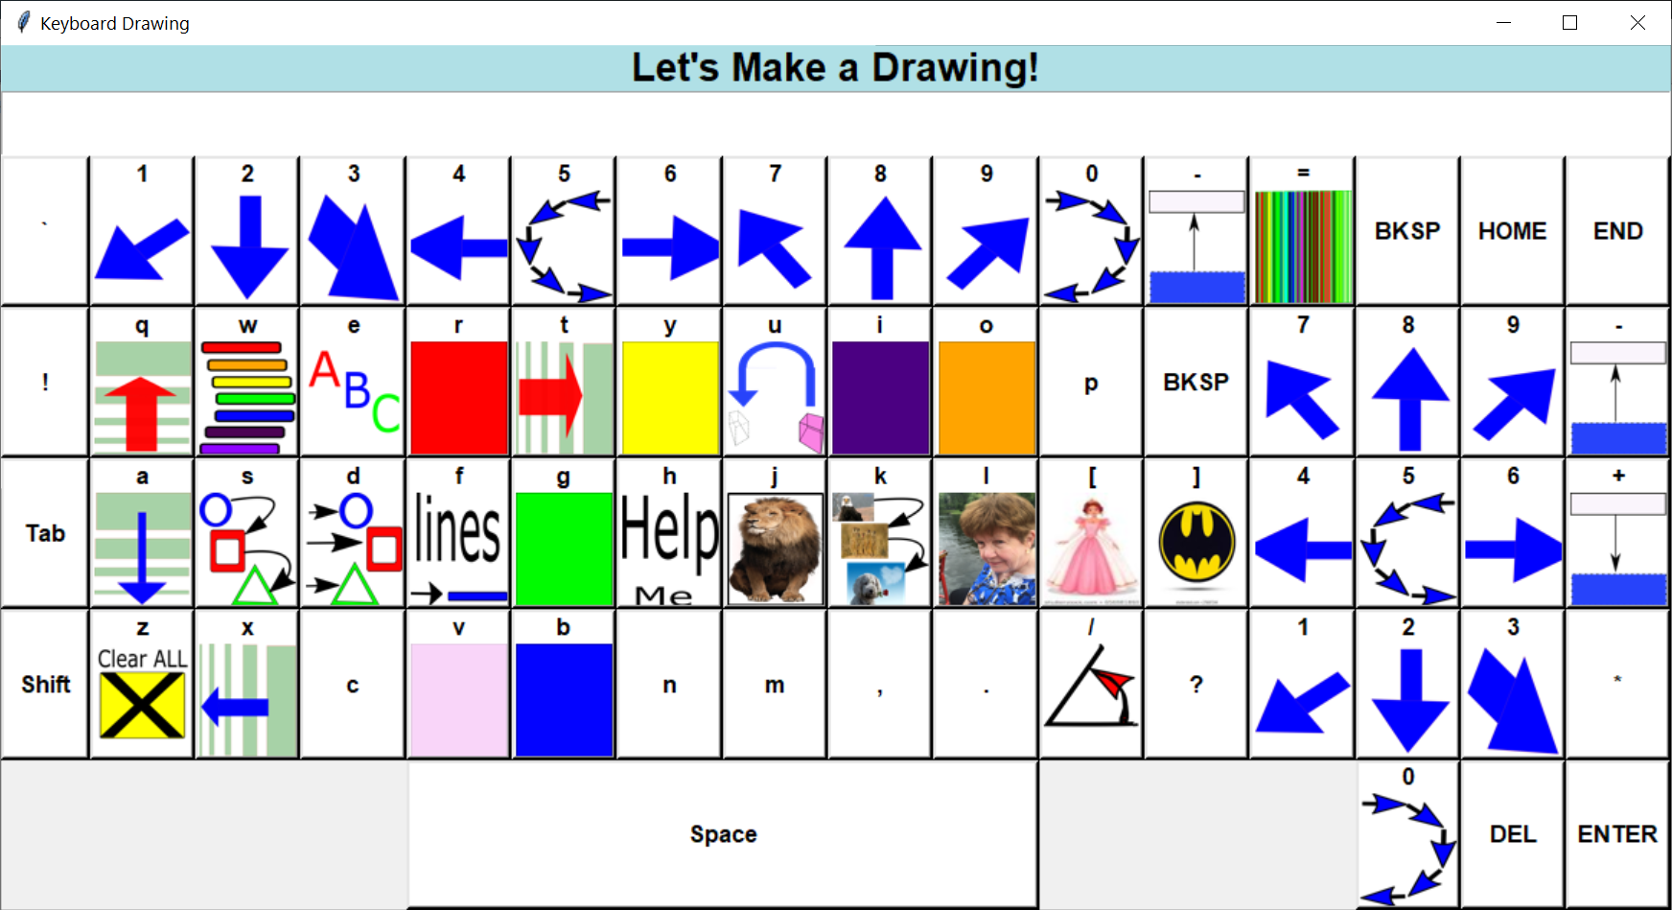
Keyboard Screen – Figure mode

Slide 10
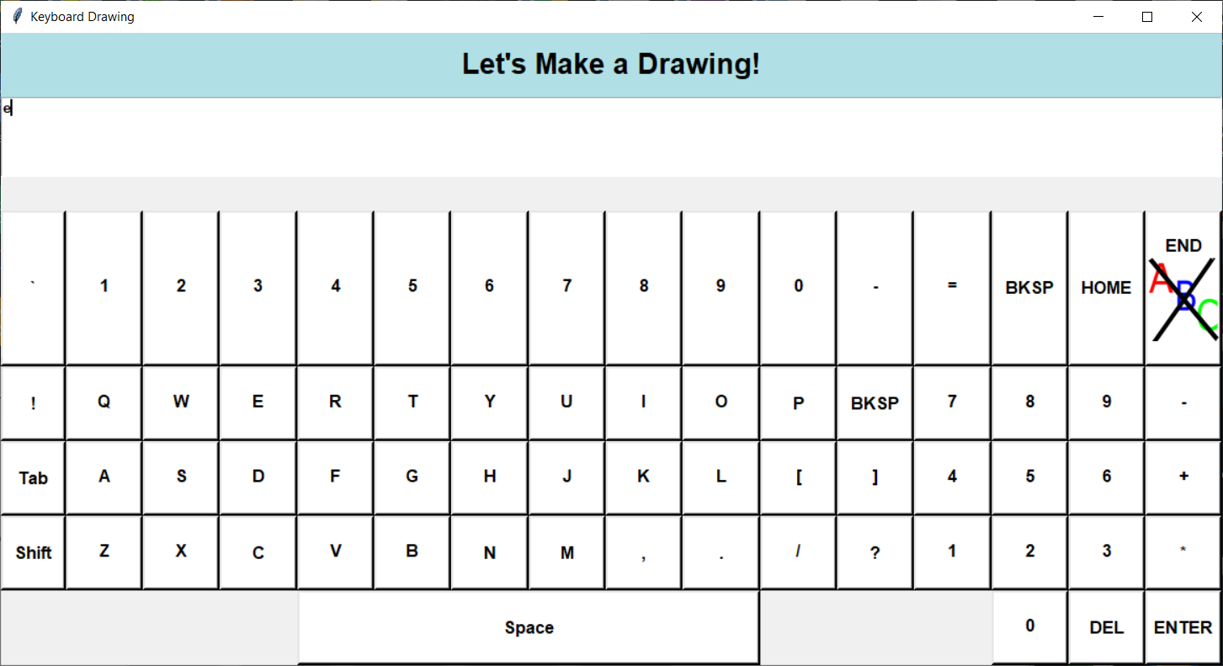
Keyboard Screen – Text mode

Slide 11
Keyboard Draw Program Structure
Main program – keyboard_draw.py
Drawing canvas – turtle and tkinter
Screen keyboard – no turtle
resource_lib/src/screen_kbd_flex.py
resource_lib/src/button_grid.py
Image file support resource_lib/…
Notes:
Started with screen_kbd.py – no support for size changing

Slide 12
Some Issues
Mixed support turtle vs tkinter
turtle, a powerful graphics tool
tkinter full graphics interface
Mixed turtle and tkinter has issues
Undo limited and more complicated

Slide 13
Some Issues - continued
Figure Modification, e.g. rotate figure
Figure built in rotation vs. undo, redo with changed parameter(new heading)

Slide 14
Detailed Walk Through the Code Mostly Bottom Up
Keyboard layout – Buttons…
button_grid.py
ButtonGrid n row by m column buttons
Button – text or text plus image
Adjustable size – buttons (and images) resize
Internal key attribute list
Enable / Disable button image display

Slide 15
ScreenKbdFlex – screen keyboard screen_kbd_flex.py
Full keyboard
Title
Echoed text region
ButtonGrid – keys
Returns clicked key – onkbd()
Internal key attribute list
Enable / Disable button image display

Slide 16
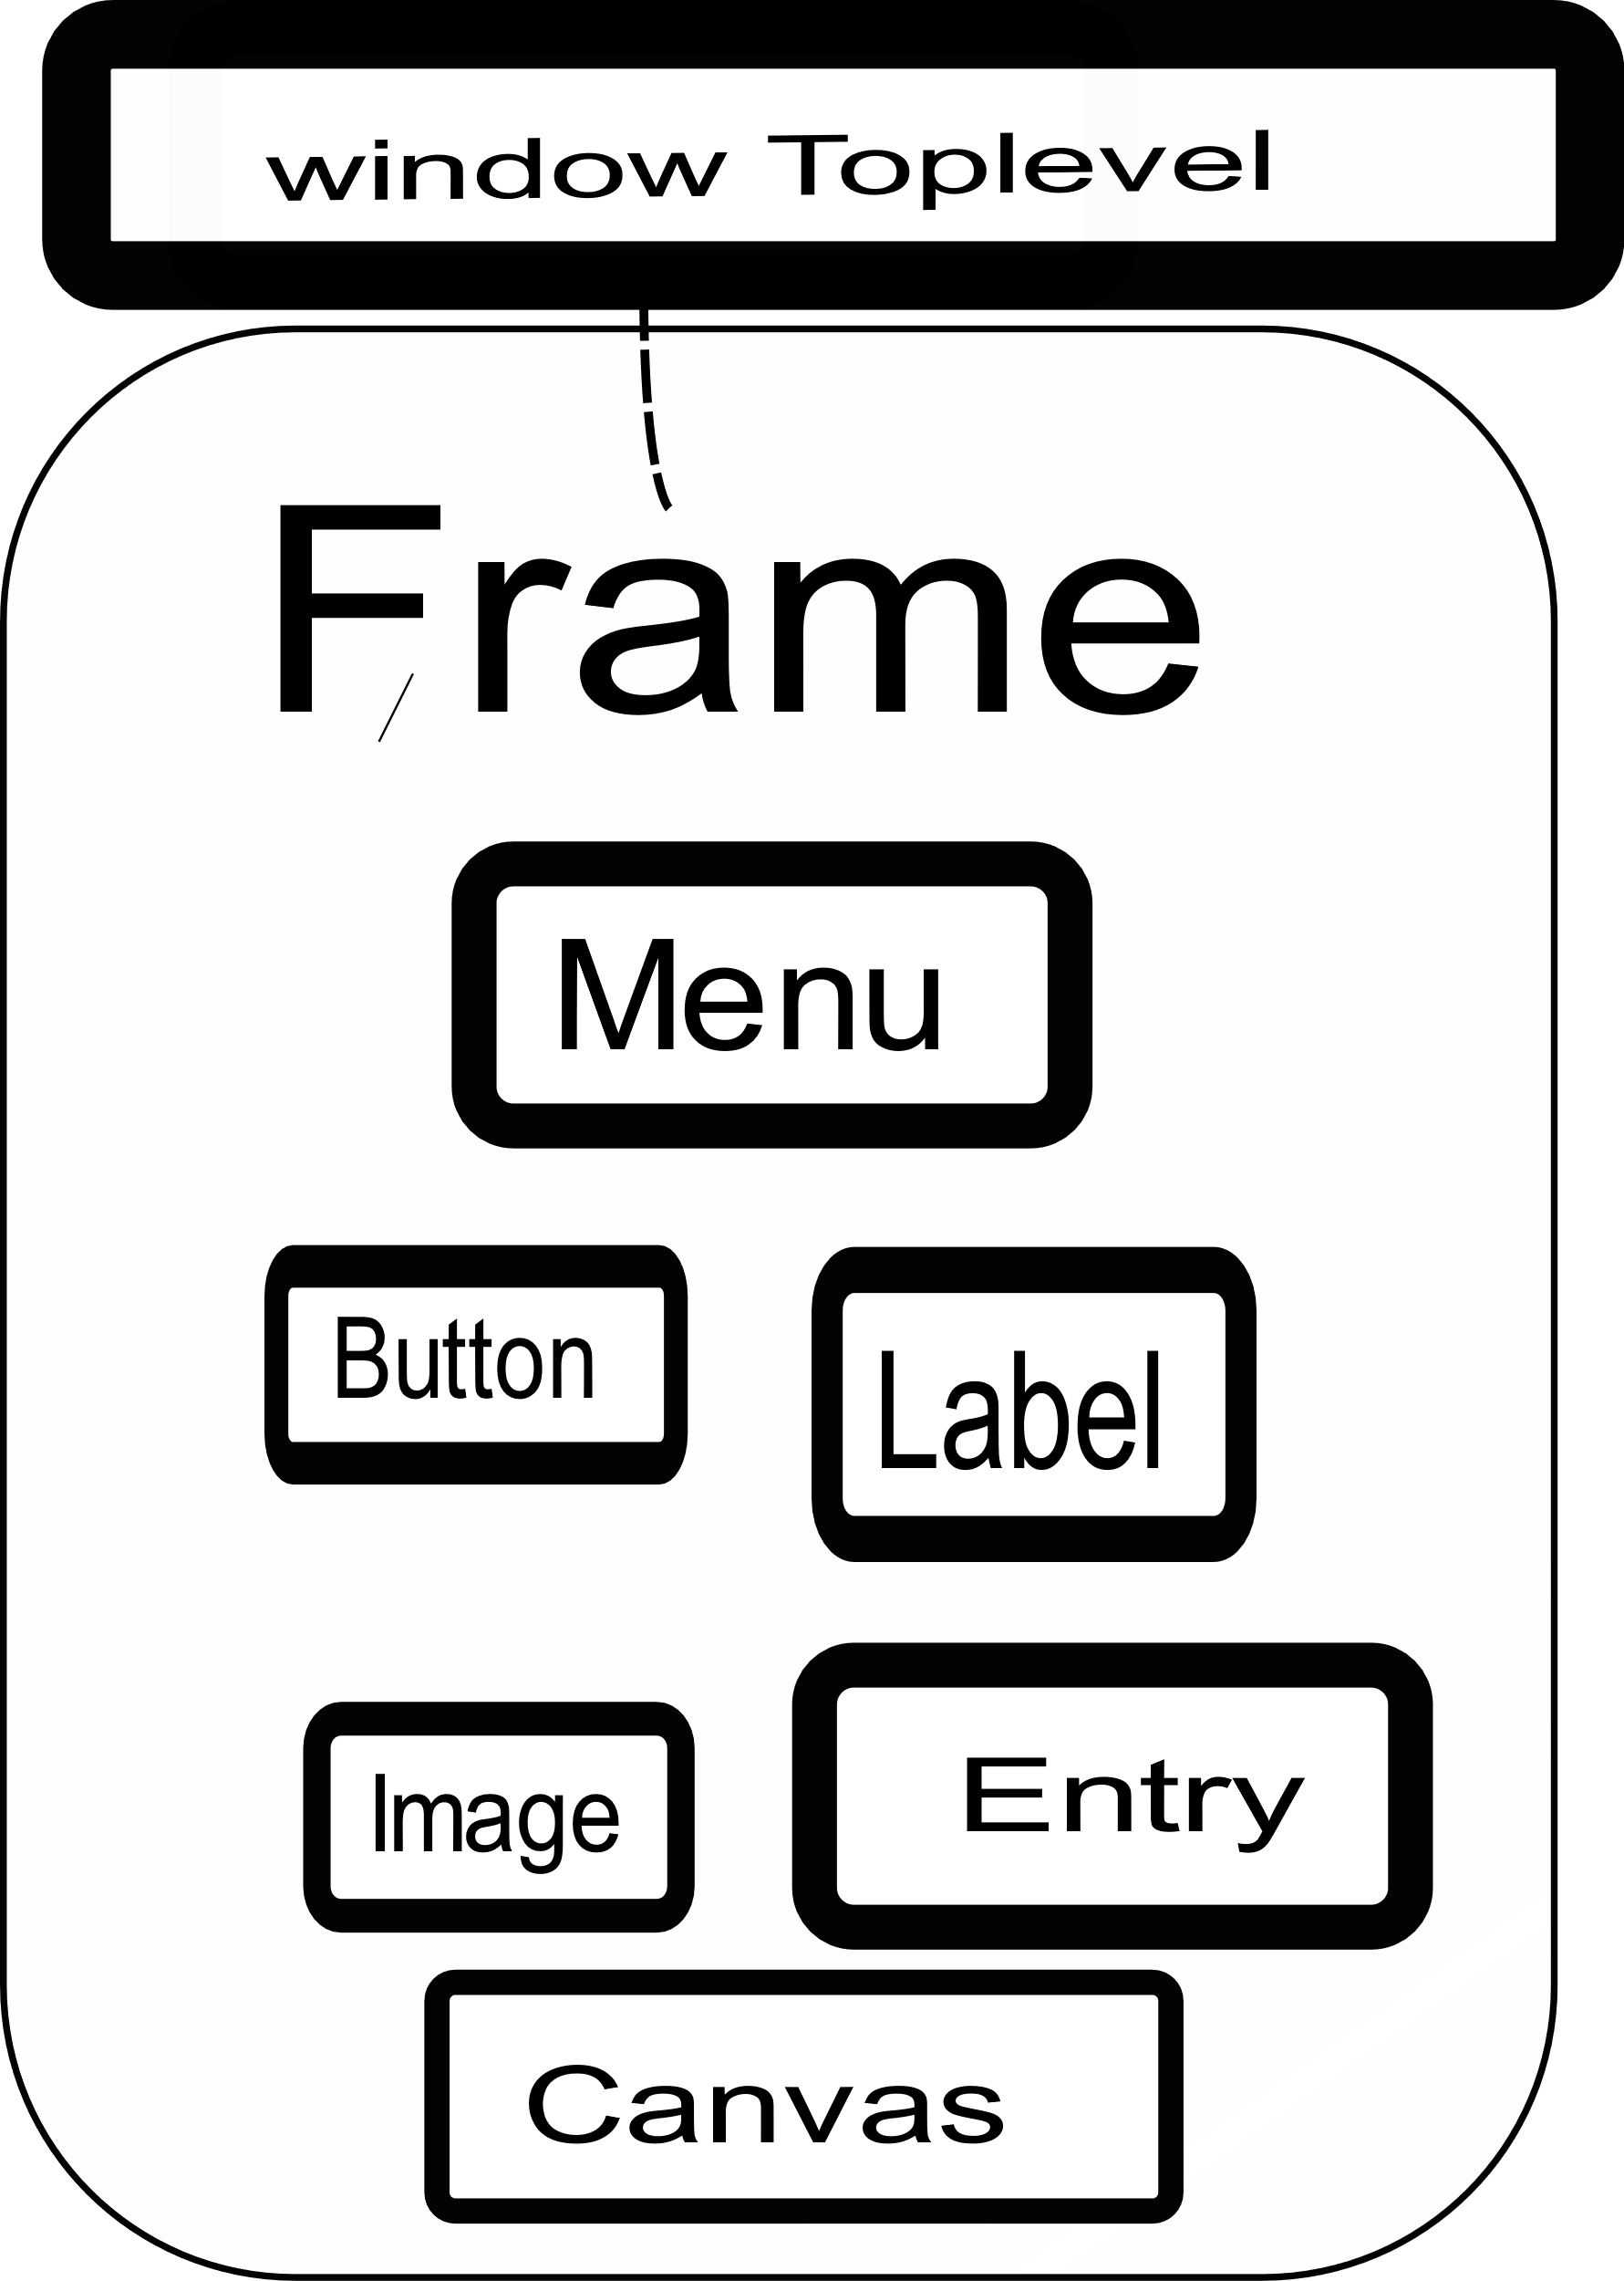
Python tkinter Display Structures – simplified
Notes:
Very similar support found in Python, Java, C++, Perl
Many more widgets

Slide 17
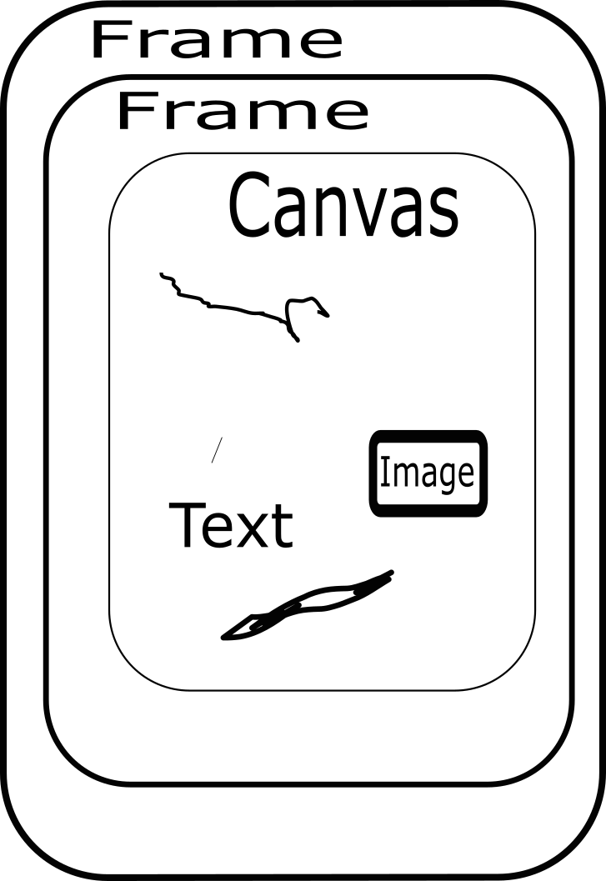
Python tkinter Display Structures – continued Drawing Support

Slide 18
Python tkinter - Event Driven
Program is a loop – mainloop()
Events ←→ Call backs
widget.bind(<event>, callback)
keybd_frame.bind('<Configure>', self.win_size_event)
btn = Button(key_frame, …, command = (lambda x =
btn_text: self.buttonClick(x)))

Slide 19
ButtonGrid Goals / Design / Hopes button_grid.py
General keyboard grid
Keys – Text and or Images
Resizable
Dynamic change, especially images

Slide 20
ButtonGrid Code button_grid.py
Setup N by M button grid
__init__()
keys: list of keys to display
key_attrs: key attributes – with image_file or other special attributes

Slide 21
ButtonGrid Code - continued button_grid.py
Use "grid" geometry for key layout
Each button uses Button widget
Button with image uses "small_image" for keys with no image

